Slide 1

Flight Ticket Price Prediction
Konatala Mohit
Intership-23 , ID-34

Slide 2

Abstract
Introduction
Descriptive Analysis
Data Visualization
Data cleaning and modifying
Feature Selection and Model Training
Conclusion

Slide 3

Abstract
Data analysis and model building on collected data from Makemytrip website to predict the ticket price of the flight travel from delhi city.

Slide 4

In this presentation I will be discussing about flight ticket price prediction using few of the machine learning models via python and its libraries. Transportation is one greatest invention of man-kind which truly helped connecting the world resources around the world. The invention of airplane was done by Wright Brothers on December 17th 1903. The invention of airplane was an indeed a revolution as it abled man-kind to travel different continent in a jiffy. It has been over a century since the invention and Flight travelling is much more convenient and comfortable and if one has hefty money even luxurious too. For today’s generation air travel has become one of the many common travelling commodities.

Slide 5

Exploratory Data Analysis
Objective:
Analysis of the data set and summarizing the factor that effect the ticket price of the air travel.
Understanding the Data Via Descriptive analysis
Size of the data is small contains only 5823 and 10 rows in train and test respectively
Price is the target column

Slide 6
Data contains Null Value in one row
Data contains both categorical data
Descriptive analysis is used as it gives the basic value Insite of the data in our dataset.
It helps in organize the data and summarize the data while describing the characteristic of data.

Slide 7
Data Visualization
Data visualization is one simplest way to get a proper idea about the characteristics of the data just from vision. In much simpler words , we Visualize the descriptive stats of the data in pictorial format. Also the data characteristic are represented in eye soothing way
Identifying pattern, understanding is the data is more easier through visuals.

Slide 8
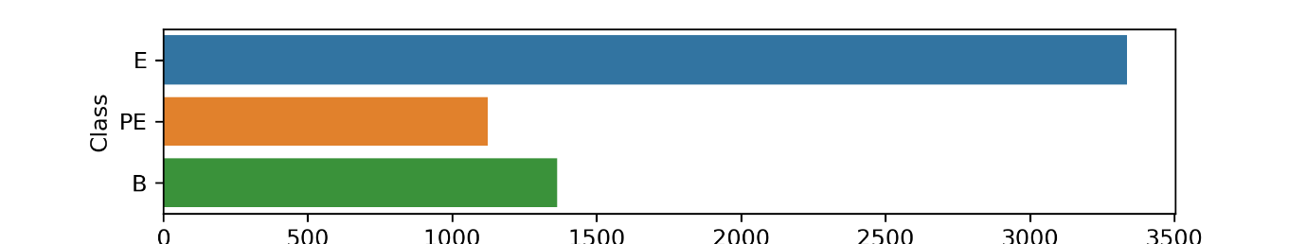
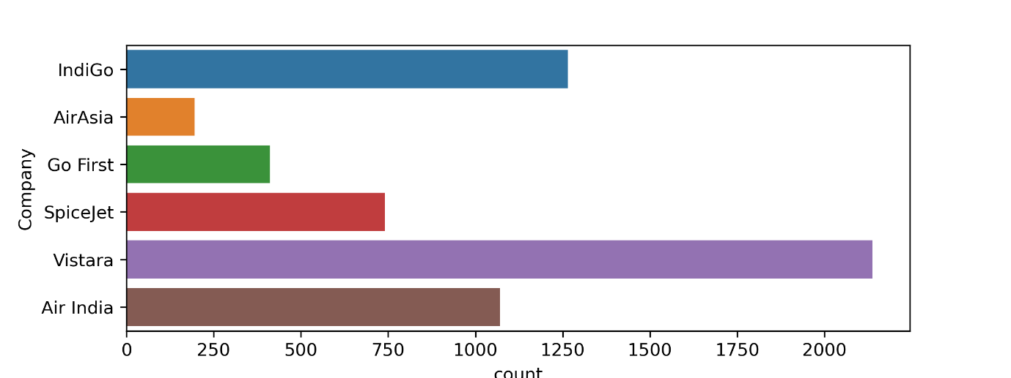
Independent variables influencing the target variable pie chart

Slide 9
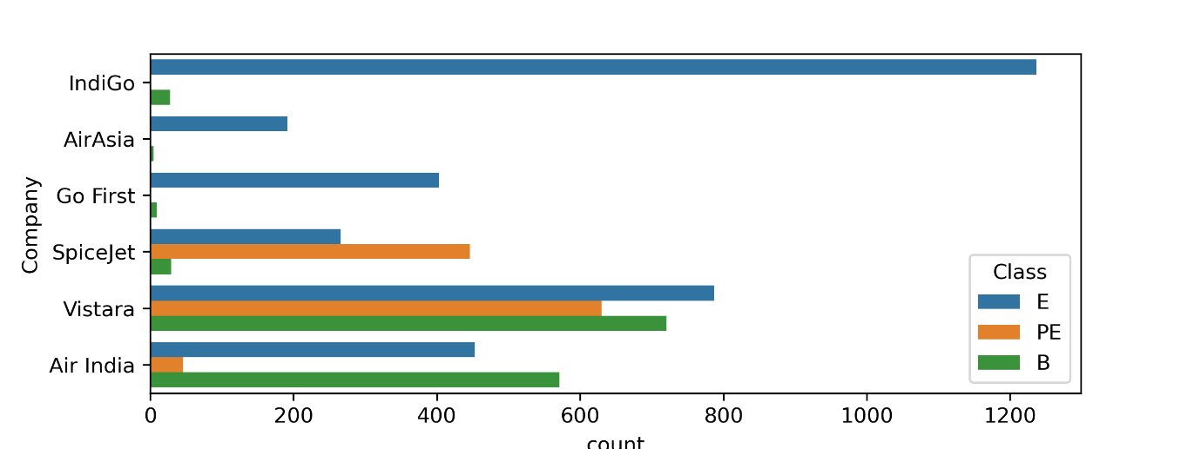
Independent variables influencing the target variable pie chart

Slide 10
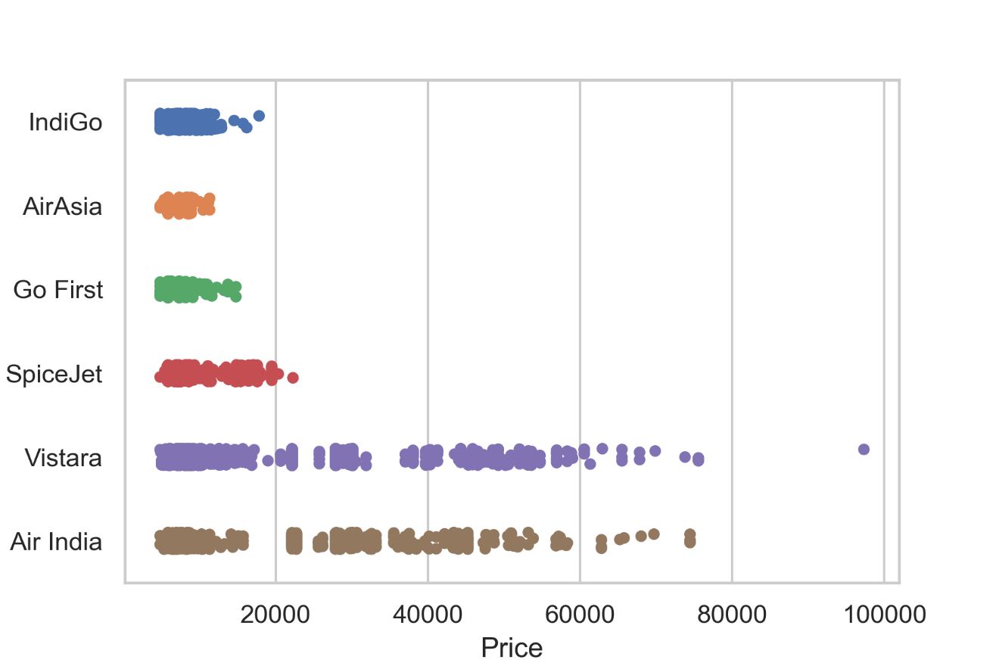
Independent variables influencing the target variable pie chart

Slide 11
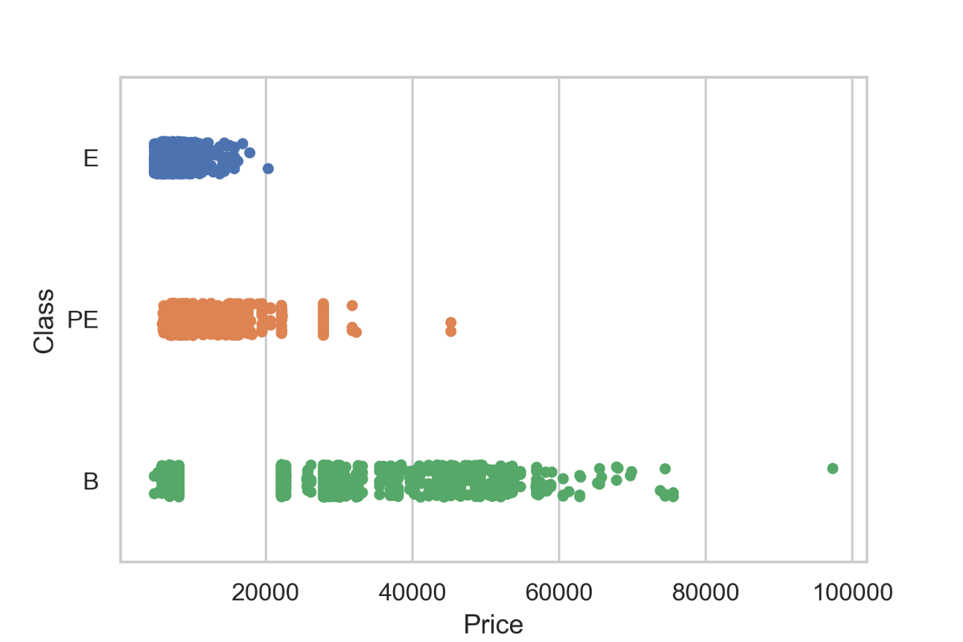
Independent variables influencing the target variable pie chart

Slide 12
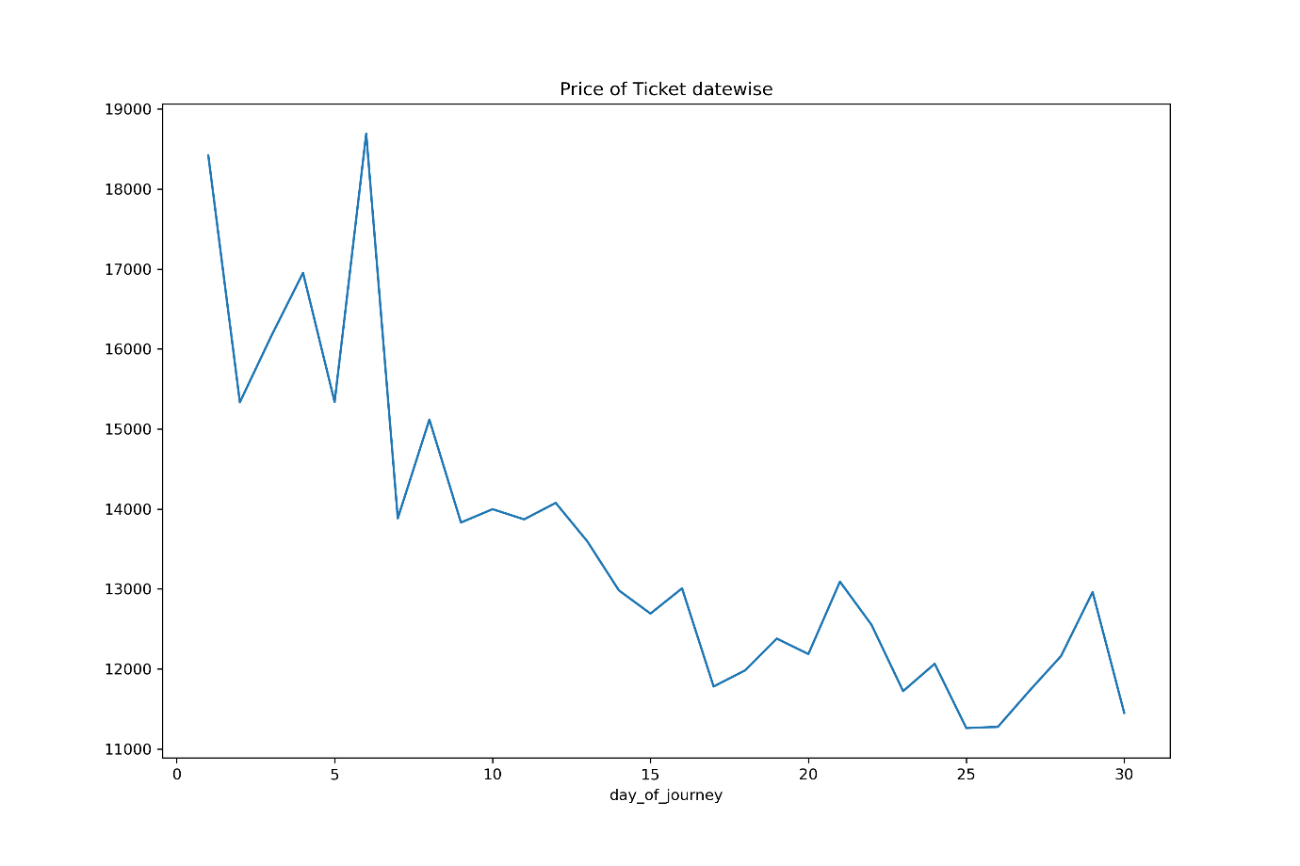
Independent variables influencing the target variable pie chart

Slide 13
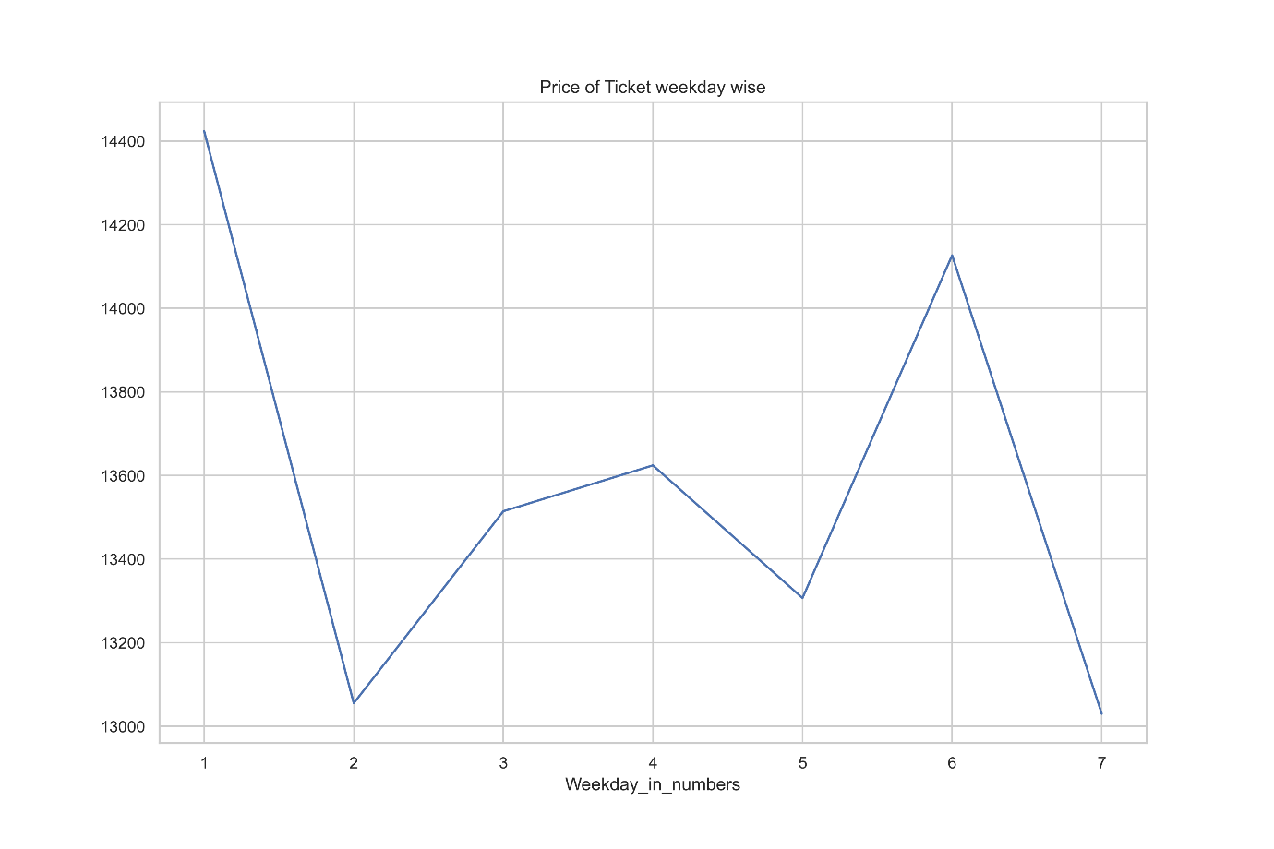
Independent variables influencing the target variable pie chart

Slide 14
Cleaning the Data
Cleaning data is one of the most important procedure in data analysis i.e. detecting and modifying or removing the inaccurate data from the dataset so as improve data quality
Tasks in data cleaning:
Handling null values
Arresting outliers
Removing Skewness if required
Feature Selection

Slide 15
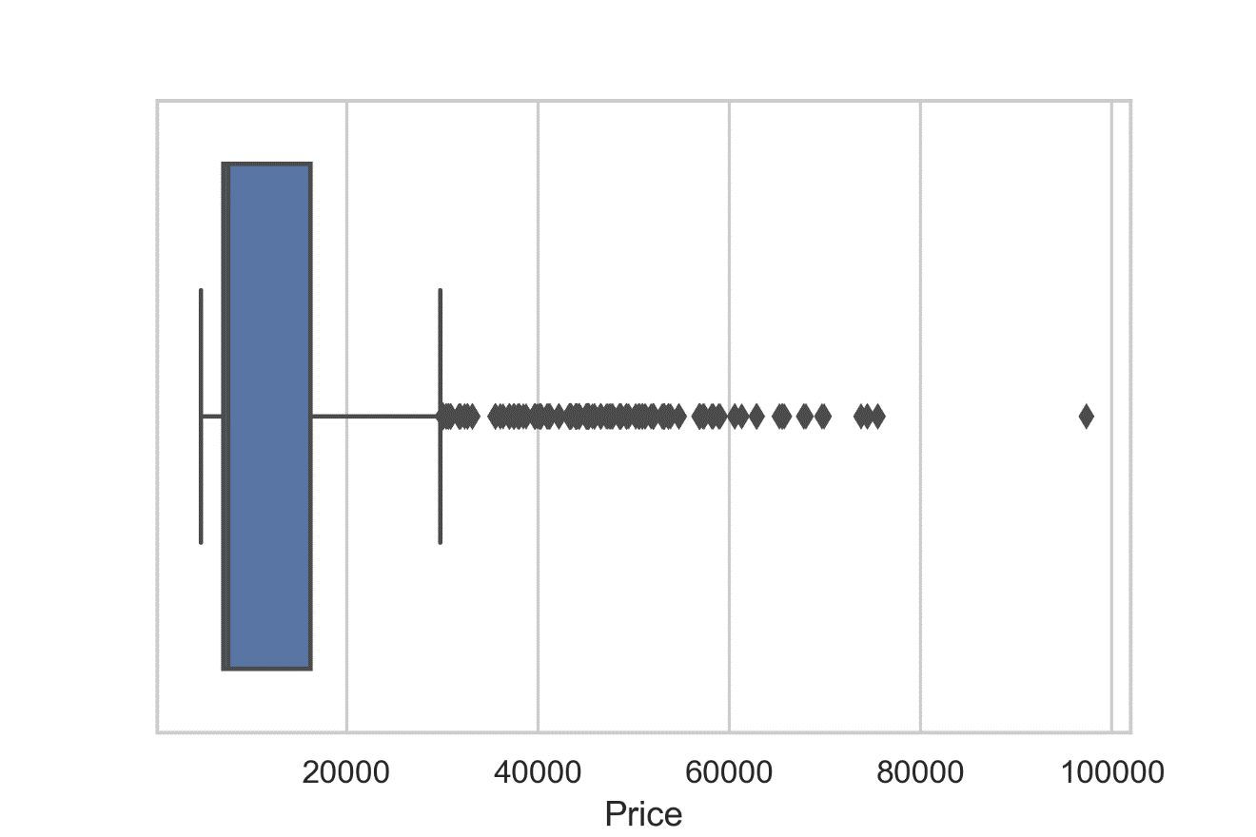
Arresting outliers observed in visualization:
Feature Selection and Normalization:
Feature selection is done on the basis of corelation (also to remove multi-collinearity) with the target variable and to improve model training. Normalization to remove bias from the data while feeding it to ML.

Slide 16
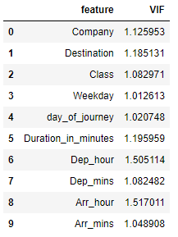
Variance Inflation Factor:
After Normalizing the data and feature selection VIF is used to cross check if there is any existence of multi-collinearity between the independent variable
Note :
VIF and Normalization should done only on independent variables i.e. after splitting the target data column.

Slide 17

Below the keys point in Summarizing the data analysis of Flight Ticket Price Prediction data:
Size of the Dataset is 5807 rows and 10 columns.
No missing values in the dataset.
Converted categorical data into numerical data
outliers have been dealt with.
Feature selection of independent data is done via heatmap and VIF value.
Separate features and prediction variables into two separate list.

Slide 18
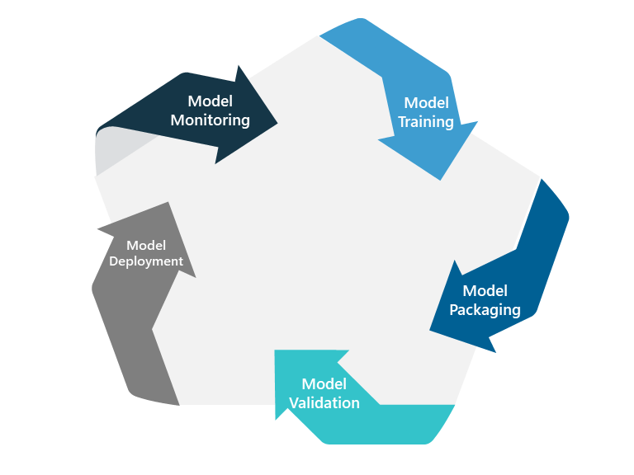
Model Training and Testing
Splitting the Data into Train and Test sets
Using hyperparameter tuning to get the best estimator for the model
Model Training
Cross Validation
Model Testing
Saving the model

Slide 19
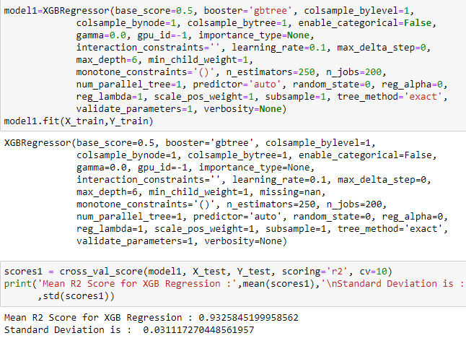

Slide 20
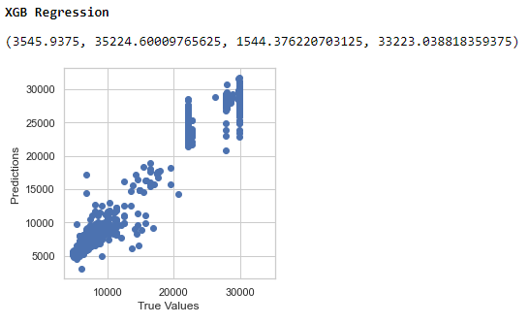

Slide 21

Limitations of this work and Scope for Future Work:
The ticket price predicted are only limited to travel from Delhi to particular given cities. When we try to predict ticket price of different city the machine learning model will fail. Also, for 2 stoppage flights tickets it will also fail as the model is not trained for 2 stoppage flights, as most of the data available are data of the one or non-stop therefore prediction of 2 stop model is always constrained. To improve the model efficiency, we can introduce various other factors such as Airbus model, baggage load and travel meals etc., inclusion of these can improve the model quality.
Conclusion:
In the whole dataset Class column has the most influence on the price of the flight ticket. Flight Travel Duration in minutes is the other good influence on the price prediction

